Slide 1
Theoretical principles of NMR Proton relaxation technology
NMR and MRI Application in Biotechnology Course

Slide 2
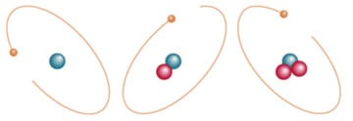
NMR- Basic Concepts
All subatomic particles (electrons, protons and neutrons) spin around their own axes.
Definition of a nuclear spin: total angular momentum of a nucleus (I).
1H
2H

Slide 3
NMR- Basic Concepts
Rules for determining the net spin of a nucleus:
If the number of neutrons and the number of protons are both even, the nucleus has no net spin. (C=6 protons and 6 neutrons => I=0)
If the number of neutron or the number of protons is odd, then the nucleus has a half-integer spin. (H= 1 proton and 0 neutron => I=1/2)
If the number of neutrons and the number of protons are both odd, then the nucleus has an integer spin. (Deuterium= 1 proton and 1 neutron => I=1)
Only nuclei that have a nuclear magnetic spin moment are observable at the NMR!!!

Slide 4
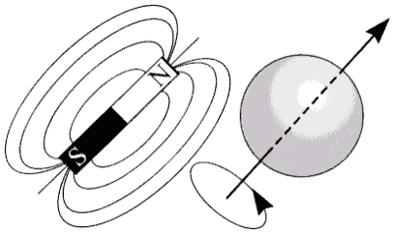

NMR- Basic Concepts
Definition of a magnetic moment)µ) :property of a magnet that interacts with an applied magnetic field to generate a mechanical moment
Magnetic moment measure of the tendency to align with a magnetic field
$μ$= g I h/2π
+
g is the gyromagnetic ratio;
I is the quantum number of nuclear spin;
h is Plank's constant.

Slide 5
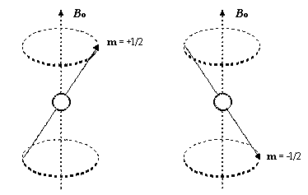
NMR- Basic Concepts
Spinning protons act like a small magnets
Spinning charge generates magnetic field
Opposite spins generates magnetic fields in opposite directions
In the absence of an external magnetic field these orientations are of equal energy

Slide 6
NMR- Basic Concepts
In the absence of an external magnetic field
Spin magnetic moments are randomly orientated
There is no bulk magnetization

Slide 7
Consequences of nucleus in external magnetic field
Larmor precession
Spin flip
Zeeman Effect
Absorption of electromagnetic radiation

Slide 8
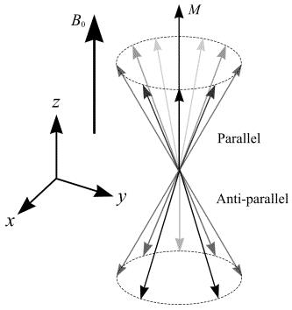
Consequences of nucleus in external magnetic field
In the presence of magnetic field: axis of rotation precess around the magnetic field.
The resonance frequency, called Larmor frequency (ω₀) and is proportional to the main magnetic field strength.
ω₀=-γB₀
μ=γhI

Slide 9
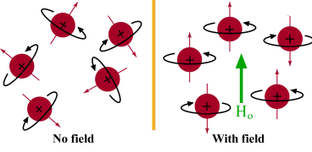
Consequences of nucleus in external magnetic field
Within the B0 magnetic field, there are more spins aligned with the field (parallel - low energy state) than spins aligned against the field (anti-parallel - high energy state).
Due to this slight excess of parallel spins, net magnetization has a longitudinal component aligned with B0.
As spins do not rotate in phase, the sum of all the microscopic transverse magnetizations of each spin is a null transverse macroscopic magnetization.

Slide 10
Consequences of nucleus in external magnetic field
Net contribution from a large number of such nuclear magnetic moments in an external magnetic field is called: net magnetization M
Net magnetization: net contribution (average sum) from all such magnetic moments
Net magnetization describes how a material responds to an applied magnetic field.

Slide 11
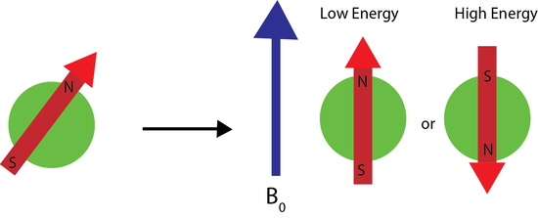
Consequences of nucleus in external magnetic field
Spin flip= splitting of spin states in the presence of external magnetic field
Application of a magnetic field to a randomly oriented bar magnet. The red arrow denotes magnetic moment of the nucleus. The application of the external magnetic field aligns the nuclear magnetic moments with or against the field.

Slide 12
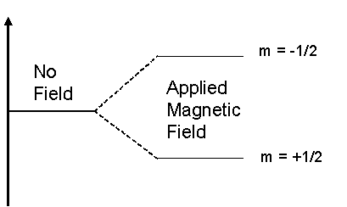
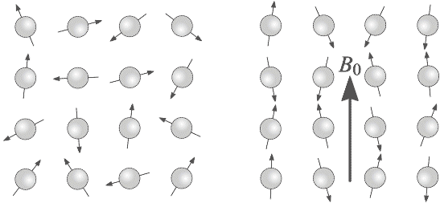
Consequences of nucleus in external magnetic field
Zeeman effect
E
β
ΔE=hω₀
m= magnetic quantum number
α
B₀=0
B₀≠0
Spin states: +I>m_{I}>-I
Number of allowed orientations: N=2I+1

Slide 13
Consequences of nucleus in external magnetic field
Absorption of electromagnetic radiation
Nucleus placed in an external magnetic field= absorb and re-emit electromagnetic radiation

Slide 14
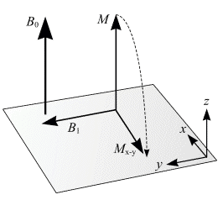
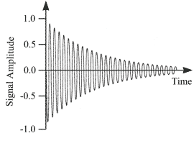
NMR Theory Overview
NMR experiments involve three basic steps:
Alignment of hydrogen magnetic moments parallel or anti-parallel with an external magnetic field.
Excitation of hydrogen protons using RF radiation.
Acquisition of intensity signals as molecules relax back to equilibrium. The intensity at each time is the sum of all resonating protons.
1
2
3

Slide 15
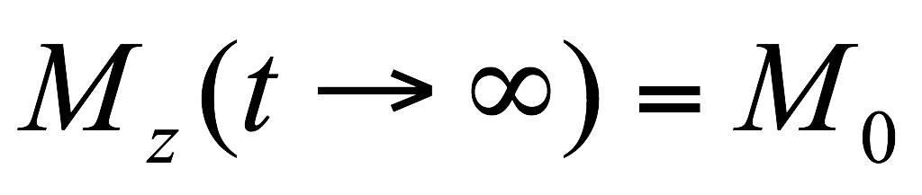
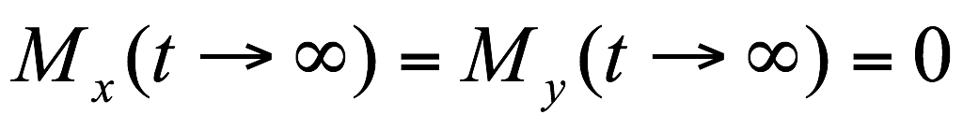
Alignment
Within the B0, there are more spins aligned with the field (low energy state) than spins aligned against the field (high energy state).
Due to the slight excess of parallel spins, net magnetization has a longitudinal component (along the Z axis) aligned with B0
As spins do not rotate in phase, the sum of all the microscopic transverse magnetizations of each spin is a null transverse net magnetization.
M_{z}=M₀
β
α
N_{α}/N_{β} =e^{(ΔE/KT)}

Slide 16
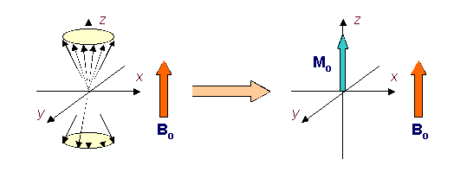
Alignment
Before irradiation, the nuclei in both spin states are processing with characteristic frequency, but they are completely out of phase, i.e., randomly oriented around the z axis.
The net nuclear magnetization M is aligned statically along the z axis (M=Mz, Mxy=0)

Slide 17
2. Excitation
Exchange of energy between two systems at a specific frequency is called resonance.
Magnetic resonance corresponds to the energetic interaction between spins and electromagnetic radiofrequency (RF).
Only protons that spin with the same frequency as the electromagnetic RF pulse will respond to that RF pulse.
The modification of spin equilibrium and absorption of electromagnetic energy by atomic nuclei, is called excitation.
When the system returns from this state of imbalance to equilibrium (relaxation), there is an emission of electromagnetic energy.

Slide 18
2. Excitation

Slide 19
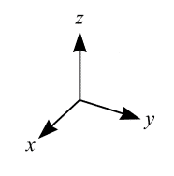
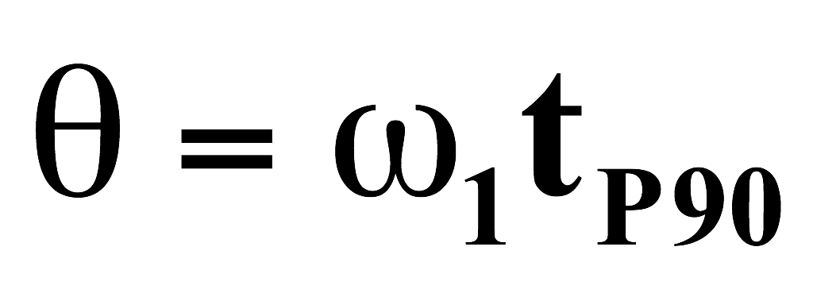
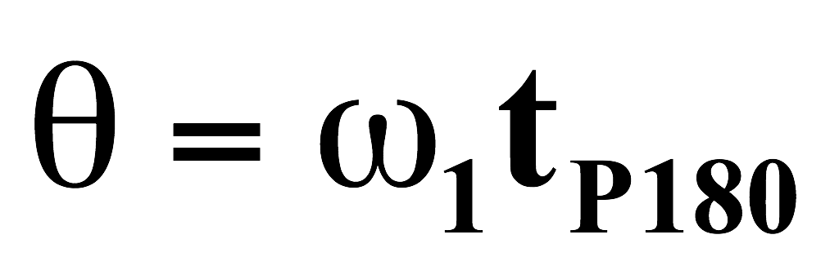
2. Excitation
When the sine-wave frequency O1 equals the Larmor precessional frequency ω₀ , then the two frequencies are said to be in ‘resonance’
β
E=hω₀
β
E=hω₀
β
Absorption
Absorption
α
α
α
Equilibrium
M_{z}=M₀
M_{z}=0
Θ=90°
M_{x}≠0
Θ=180°
B₁
B₁
M_{y}=0
M_{y}=0
M_{y}=0
M_{x}=0
M_{x}=0
M_{z}=-M₀

Slide 20
2. Excitation
The net magnetization vector can be broken down into a longitudinal component and a transverse component
During excitation, longitudinal magnetization decreases and a transverse magnetization appears (except for a 180° flip angle).
Longitudinal magnetization is due to a difference in the number of spins in parallel and anti-parallel state.
Transverse magnetization is due to spins getting into phase coherence.
M has a component in the x, y plan, M_{xy}=Msinα.
α is the tip angle which is determined by the power and duration of the electromagnetic RF pulse.
z
α
M_{o}
x
x
B₁
M_{xy}
y
ω_{o}
y
90° pulse

Slide 21
3. Relaxation Mechanisms
After irradiation ceases, not only do the population of the states revert to a Boltzmann distribution, but also the individual nuclear magnetic moments begin to lose their phase coherence and return to a random arrangement around the z axis.
The return of the equilibrium of the net magnetization is called “relaxation process”
During relaxation, electromagnetic energy is retransmitted: this RF emission is called the NMR signal.
NMR spectroscopy record this process!!!
There are two types of relaxation process : T1(spin-lattice relaxation) & T2(spin-spin relaxation)

Slide 22
3. Relaxation Mechanisms
The mechanisms for relaxation have to perform two functions:
Rebuild the original Boltzmann distribution of nuclear populations so that N_{α} > N_{β}, i.e. make M = M₀ on the +Z axis.
Destroy the phase coherence of the individual μ vector components which make up M so that when they reach the +Z axis they will once again have random orientations
Two relaxation processes:
Longitudinal (spin-lattice)
Transverse (spin-spin(

Slide 23
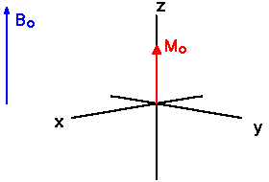
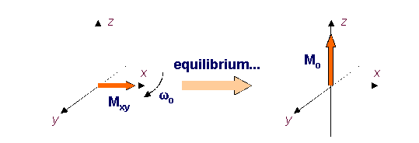
3. Relaxation Mechanisms
T1 (the spin lattice or longitudinal relaxation)
Longitudinal relaxation is due to energy exchange between the spins and surrounding lattice (spin-lattice relaxation), re-establishing thermal equilibrium. As spins go from a high energy state back to a low energy state, RF energy is released back into the surrounding lattice.
How long after a short immersion in a external field does it take for a collection of nuclei to reach Boltzmann energy distribution
It’s a time dependence exponential decay process of Mz components
dM_{z}/dt=-(M_{z}-M_{z,eq})/T1

Slide 24
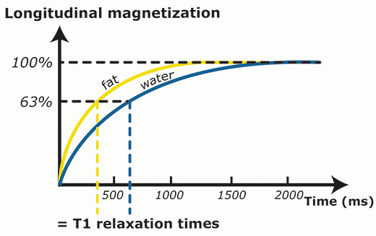
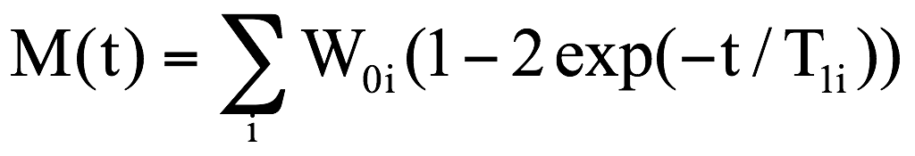
3. Relaxation Mechanisms
T₁ describes the time for longitudinal magnetization to return to equilibrium due to energy transferred to the lattice as thermal energy.
The recovery of longitudinal magnetization follows an exponential curve
After time T1, longitudinal magnetization has returned to 63 % of its final value.

Slide 25
3. Relaxation Mechanisms
T2 (the spin –spin relaxation)
This process for nuclei begin to lose their phase coherence and return to a random arrangement around the z axis is called spin-spin relaxation.
The decay of Mxy is at a rate controlled by the spin-spin relaxation time T2
dMx/dt=-Mx/T2
dMy/dt=-My/T2
dephasing

Slide 26
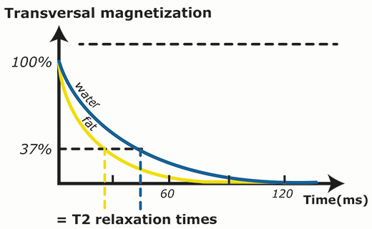
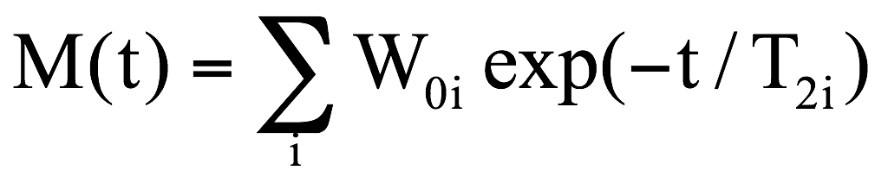
3. Relaxation Mechanisms
T₂ describes the time for transverse magnetization to return to equilibrium due to coherence lost caused by spin-spin interactions.
Transverse magnetization decay is described by an exponential curve, characterized by the time constant T2.
After time T2, transverse magnetization has lost 63 % of its original value.
Transverse relaxation is faster than longitudinal relaxation.
T2 is tissue-specific and is always shorter than T1
T2 values are unrelated to field strength.

Slide 27
3. Relaxation Mechanisms
The correlation time roughly corresponds to the average time it takes for a molecule to progress through one radian via random molecular tumbling.
T₁: The rate constant for rebuilding Boltzmann distribution
T₂: The rate constant for destroying phase coherence
High
Mobility
Low
Small molecules
Large molecules

Slide 28
Comparison between T1 and T2
T1 relaxation | T2 relaxation
Longitudinal (along z-axis( | Transverse (x-y plane)
Energy exchange between the spins and the surrounding lattice | Interaction between the spins and their magnetic fields
Return of the spins from higher to lower anergy state | Cumulative loss of phase coherence
Re-establishes the thermal equilibrium | Decay of the excited transverse magnetization
Longitudinal magnetization returns to 63% of its original value | Transverse magnetization loses 63% of its original value
Follows an exponential curve | Follows an exponential curve

Slide 29
Contact Information
Prof. Zeev Wiesman: wiesman@bgu.ac.il
Maysa Resende: mteixeiraresende@gmail.com
Dr. Janna Abramovich: janna@bgu.ac.il
Shosh Kravchick: kravch@bgu.ac.il
Plant Lipid Biotechnology Lab phone number: 074-7795272

